Slide 1
IOT BASED
AIR QUALITY
MONITORING SYSTEM
MINOR PROJECT
BY :- SUPERVISOR:-
VIPUL PAHUJA :- 9917102206 DR.JITENDRA MOHAN
PREETIKA GUPTA :- 9917102250
RISHABH JAIN :- 9917102223

Slide 2
ABOUT THE PROJECT
. ESP32 Node MCU-based Air Quality monitoring system to check particulate matter (PM), humidity , temperature and hazardous gases likeNH3,alcohol,benzene and CO2 like .
. Various environmental conditions of the place are tested and displayed on the TFT display as well as on ThingSpeak IoT (Internet of Things) platform.

Slide 3
COMPONENTS REQUIRED
ESP 32 NodeMCU
DHT11 Sensor
MQ 135 Sensor
SDS011
THINGSPEAK IOT PLATFORM
RESISTORS
BREAD BOARD
JUMPER WIRES

Slide 4
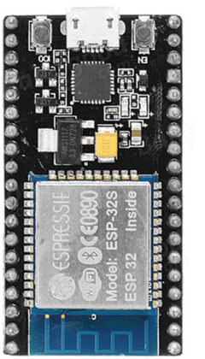
ESP32 NODE MCU
It is a low-power microcontroller (MCU) with integrated Wi-Fi and dual-mode Bluetooth—it is a successor of ESP8266 MCU.
Arduino IDE is used to upload the sketch to ESP32 NodeMCU.
https://www.google.com/search?q=esp32+wroom&sxsrf=ACYBGNTyNrPpygwAY4uwCgA-q6cnZQCVnw:1574263318971&source=lnms&tbm=isch&sa=X&ved=2ahUKEwi50aPvi_nlAhUHQI8KHeiFBe0Q_AUoAXoECA4QAw#imgrc=CZXqvopd7yCHVM:

Slide 5
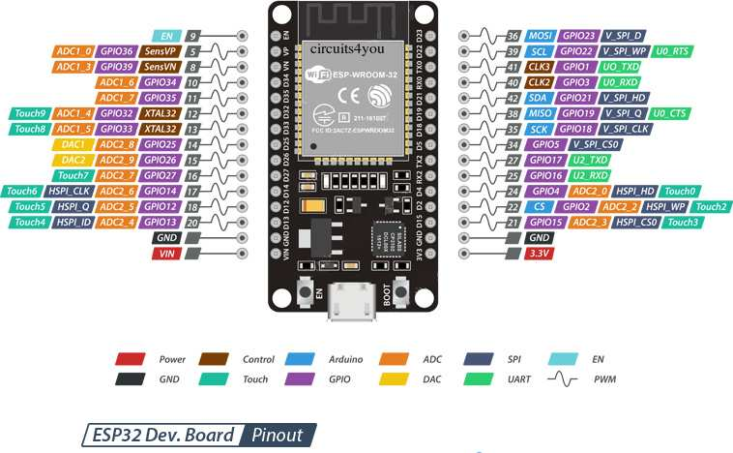
https://circuits4you.com/2018/12/31/esp32-devkit-esp32-wroom-gpio-pinout/

Slide 6
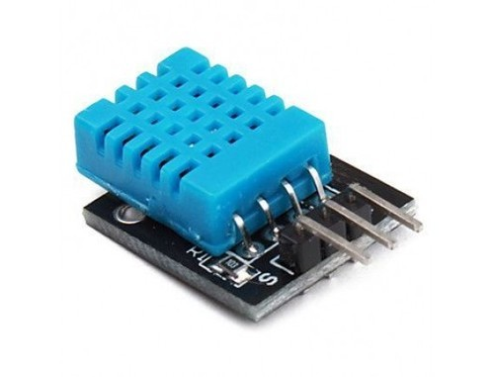
DHT11 SENSOR
The DHT11 is a basic, low- cost digital temperature and humidity sensor.
It uses a capacitive humidity sensor and a thermistor to measure the surrounding air, and spits out a digital signal on the data pin .
https://components101.com/dht11-temperature-sensor

Slide 7
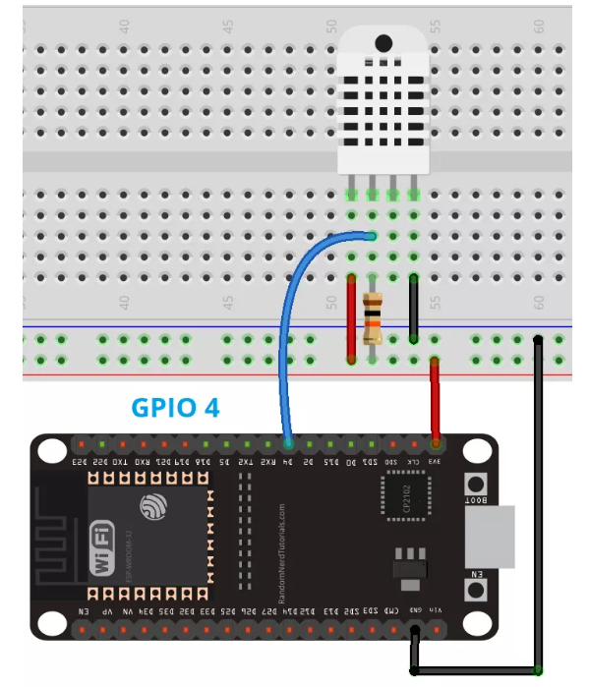
DHT11 CONNECTION WITH ESP32
https://lastminuteengineers.com/esp32-dht11-dht22-web-server-tutorial/

Slide 8
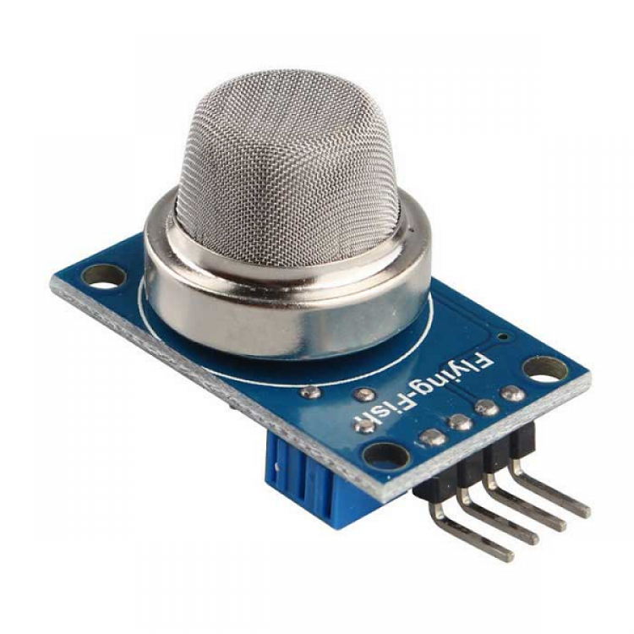
MQ135 GAS SENSOR
Air quality sensor for detecting a wide range of gases, including NH3, NOx, alcohol, benzene, smoke and CO2.
It has high sensitivity to Ammonia, Sulfide and Benzene steam, also sensitive to smoke and other harmful gases.
https://robu.in/product/mq-135-air-quality-detector-sensor-module-arduino/

Slide 9
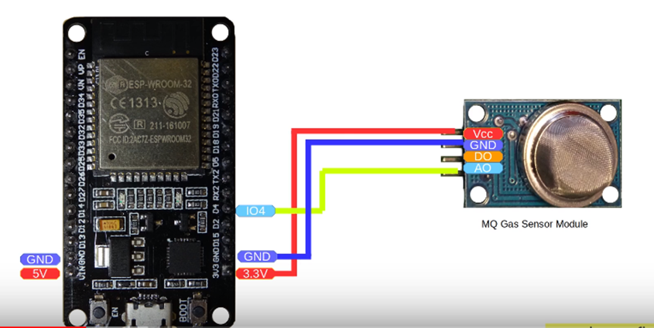
MQ135 CONNECTION WITH ESP32
https://iotdesignpro.com/projects/iot-based-air-quality-monitoring-system-with-twitter-notification

Slide 10
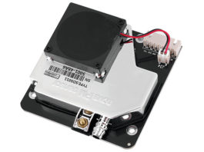
NOVA DUST SENSOR - SDS011
Nova dust sensor SDS011 is one of the best particulate sensors in terms of size, accuracy and price.
It has a UART interface and measurement resolution of 0.3µg/m3. Operating voltage is 5V.
https://www.tinytronics.nl/shop/en/sensors/temperature-air-humidity/nova-sds011-high-precision-laser-dust-sensor

Slide 11
SDS011 CONNECTION WITH ESP32
SDS011 | ESP32
5V | Vin/5V
GND | GND
TX | RX2(D16)
RX | TX2(D17)
https://blog.jokielowie.com/en/2017/10/esp-32-sds011-smog-quick-wifi-sensor/

Slide 12
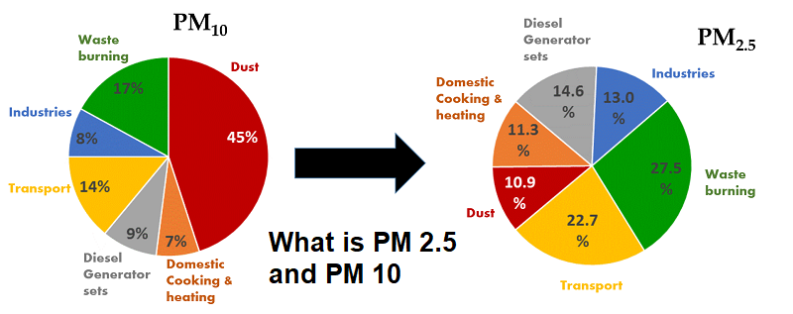
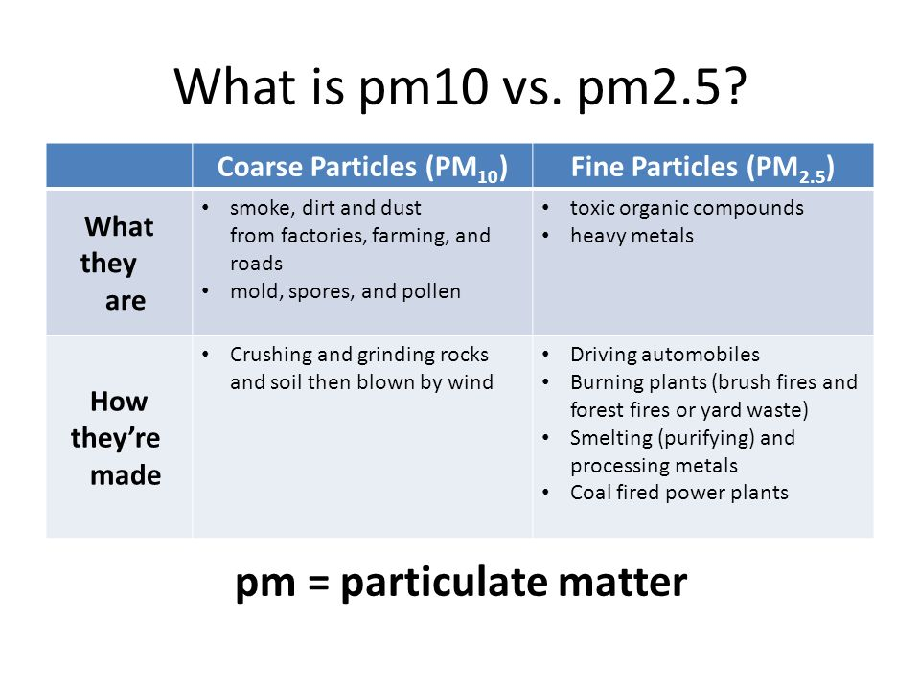
https://www.sciencedirect.com/science/article/pii/S1674200113002150

Slide 13
THINGSPEAK IOT PLATFORM
The project is based on ThingSpeak cloud computing. ThingSpeak is an open source IoT application and API to store and retrieve data.
It enables the creation of sensor-logging applications, location-tracking applications and a social network of things with status updates.
This means, if you send data from the sensors to ThingSpeak at regular intervals, it will create, store and display data in a trend automatically

Slide 14
SOFTWARE
Coding for the project will be done in Arduino programming language.
SDS011 on ESP32. ESP32 works on Arduino IDE. Since Arduino is an advanced technology, there is a library available for almost all sensors.
So, for SDS011 there is a ready-made library available that uses SoftwareSerial library.

Slide 15
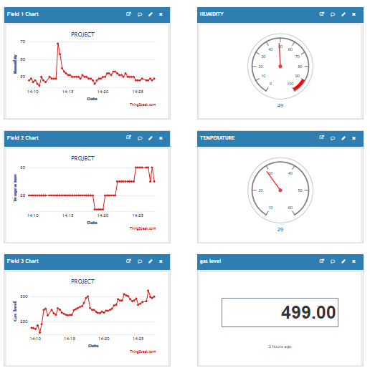
GRAPHS ON THINGSPEAK PLATFORM

Slide 16
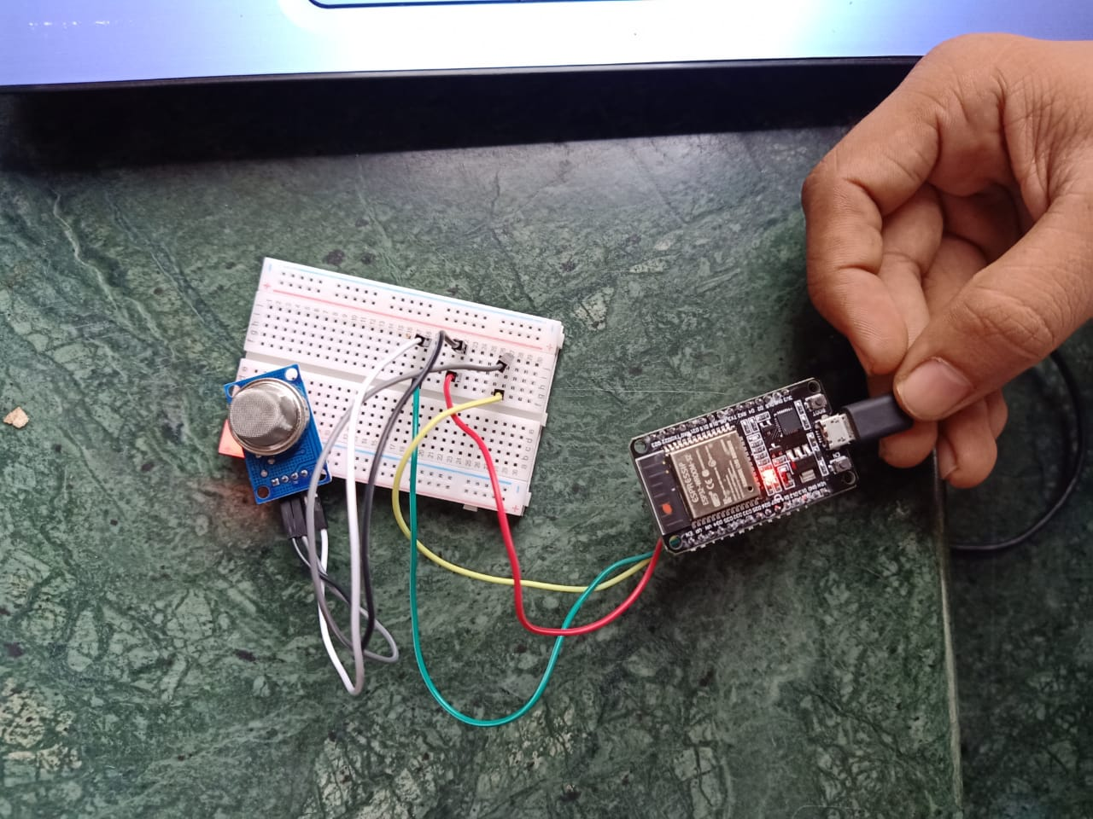
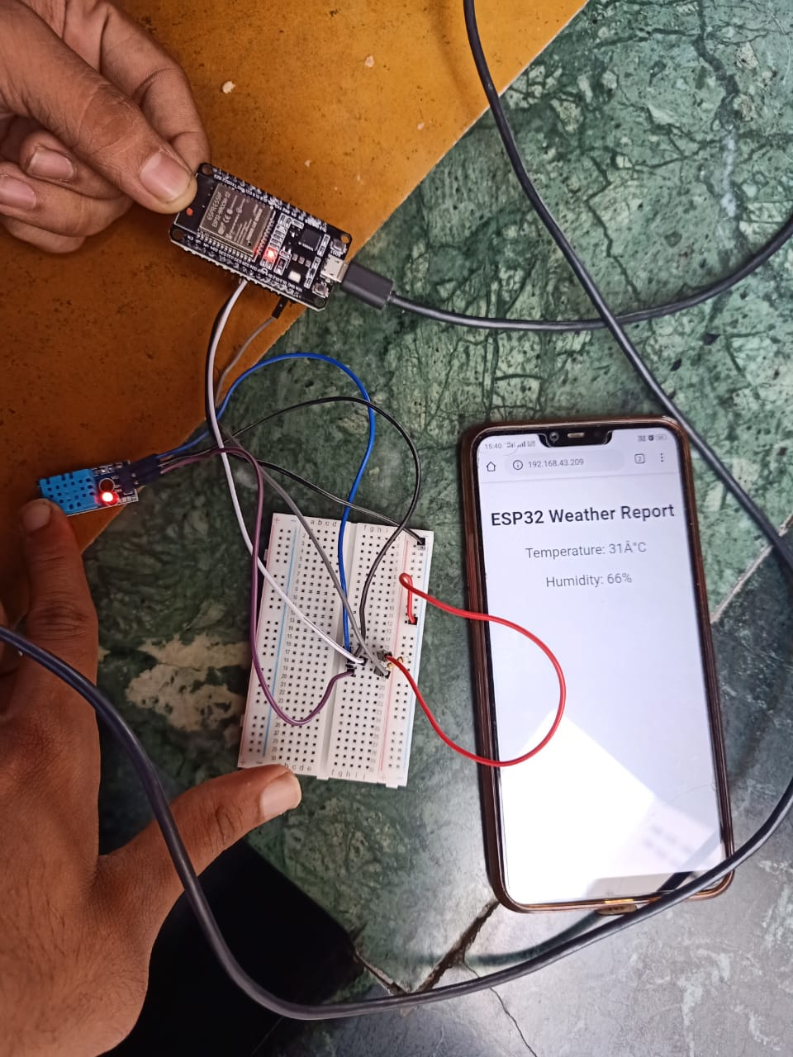
ACTUAL PHOTOGRAPHS
(MQ135 AND DHT11 IMPLEMENTATION)

Slide 17
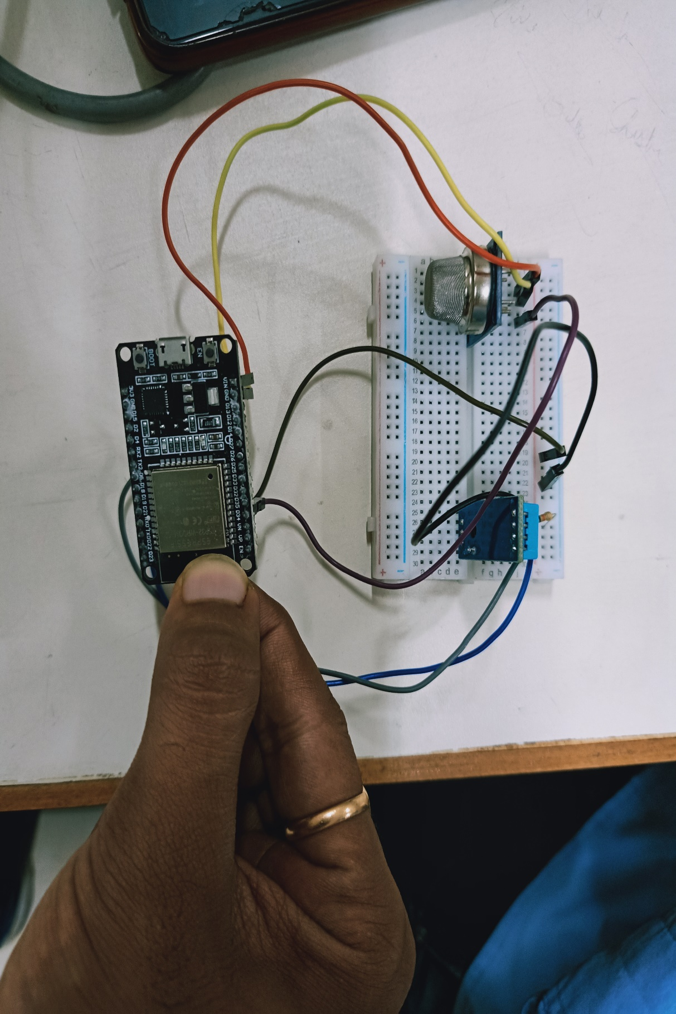
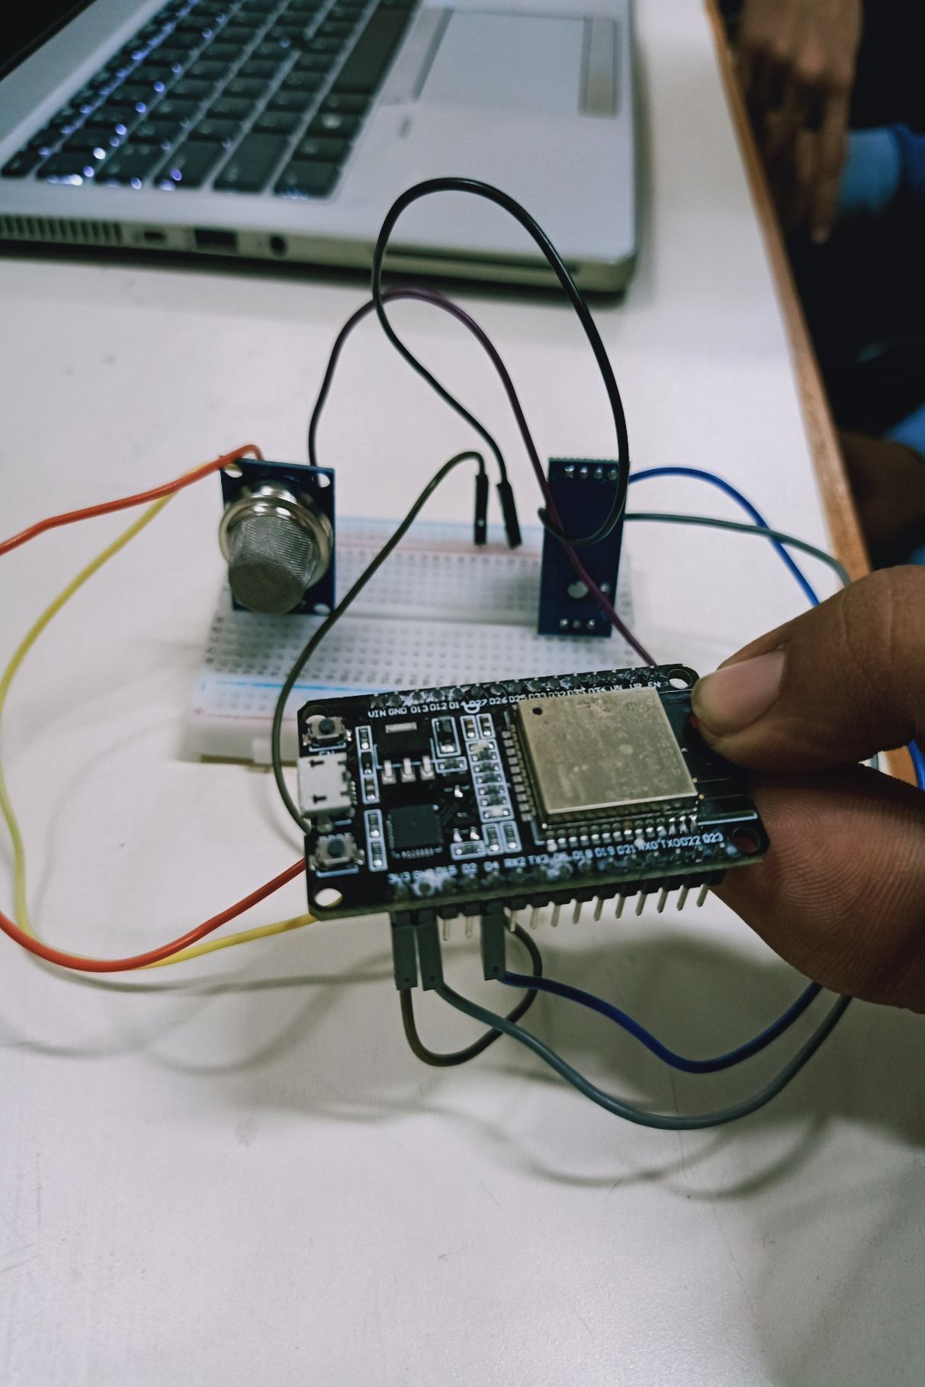

Slide 18
CONCLUSIONS
The developed air quality monitoring system accurately detects the presence of pollutants in atmosphere, humidity and temperature.
The present system has been integrated with IOT framework which is used to measure and monitor the pollutants, temperature and humidity in real–time.
The Thingspeak IOT platform not only measures and monitors the given parameters but also plot live graphs for better visualization of parameters

